Slide 1
Outline
1
2
Poincare Plot
Robust indices - CSI & CPI
3
4
IPFM Model
What are Laguerre functions and how they eliminate the frequency approach of LF and HF SAI & PAI

Slide 2
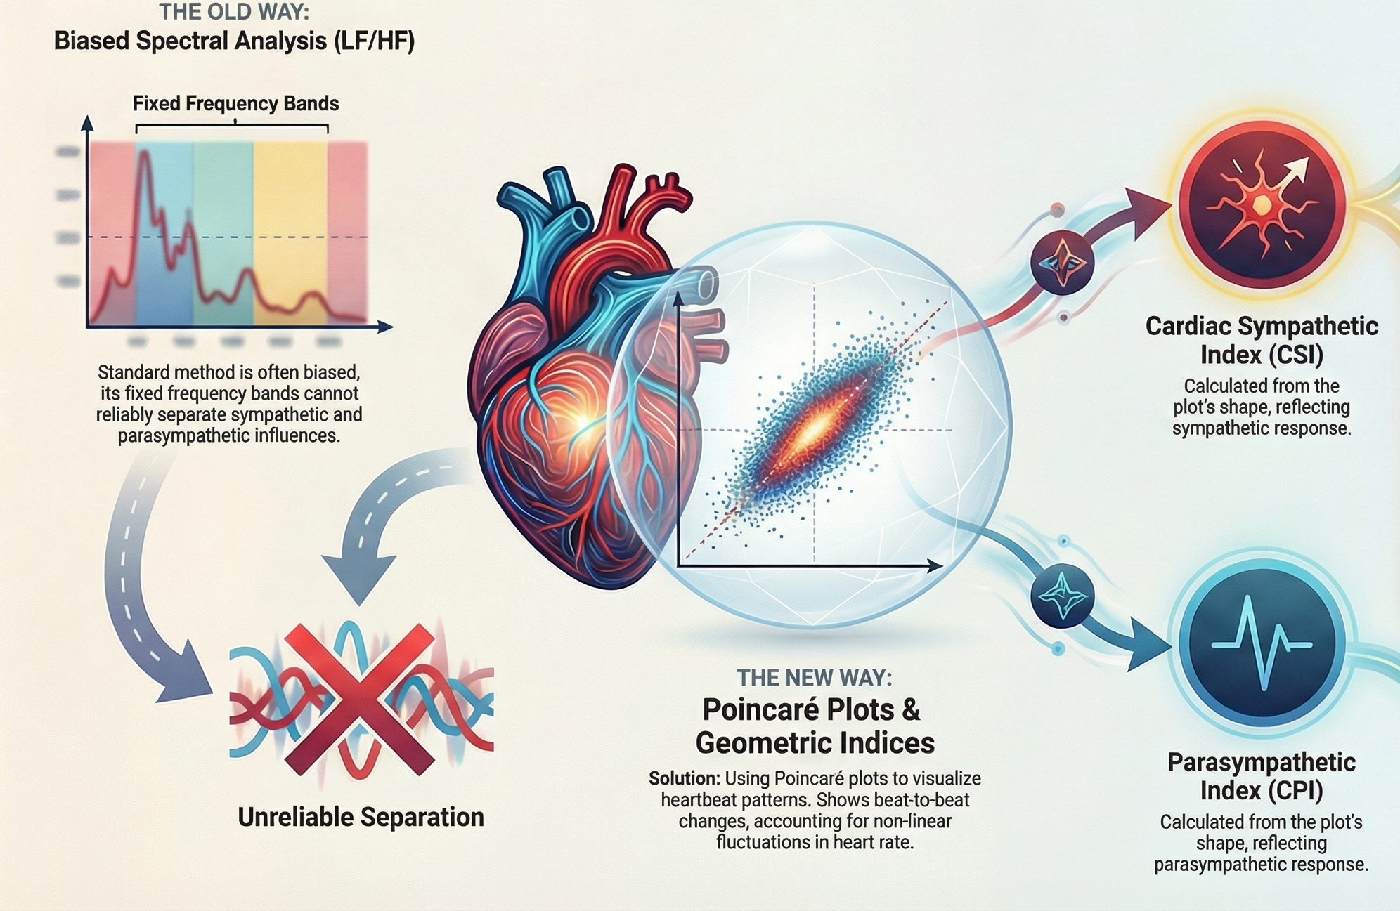

Slide 3
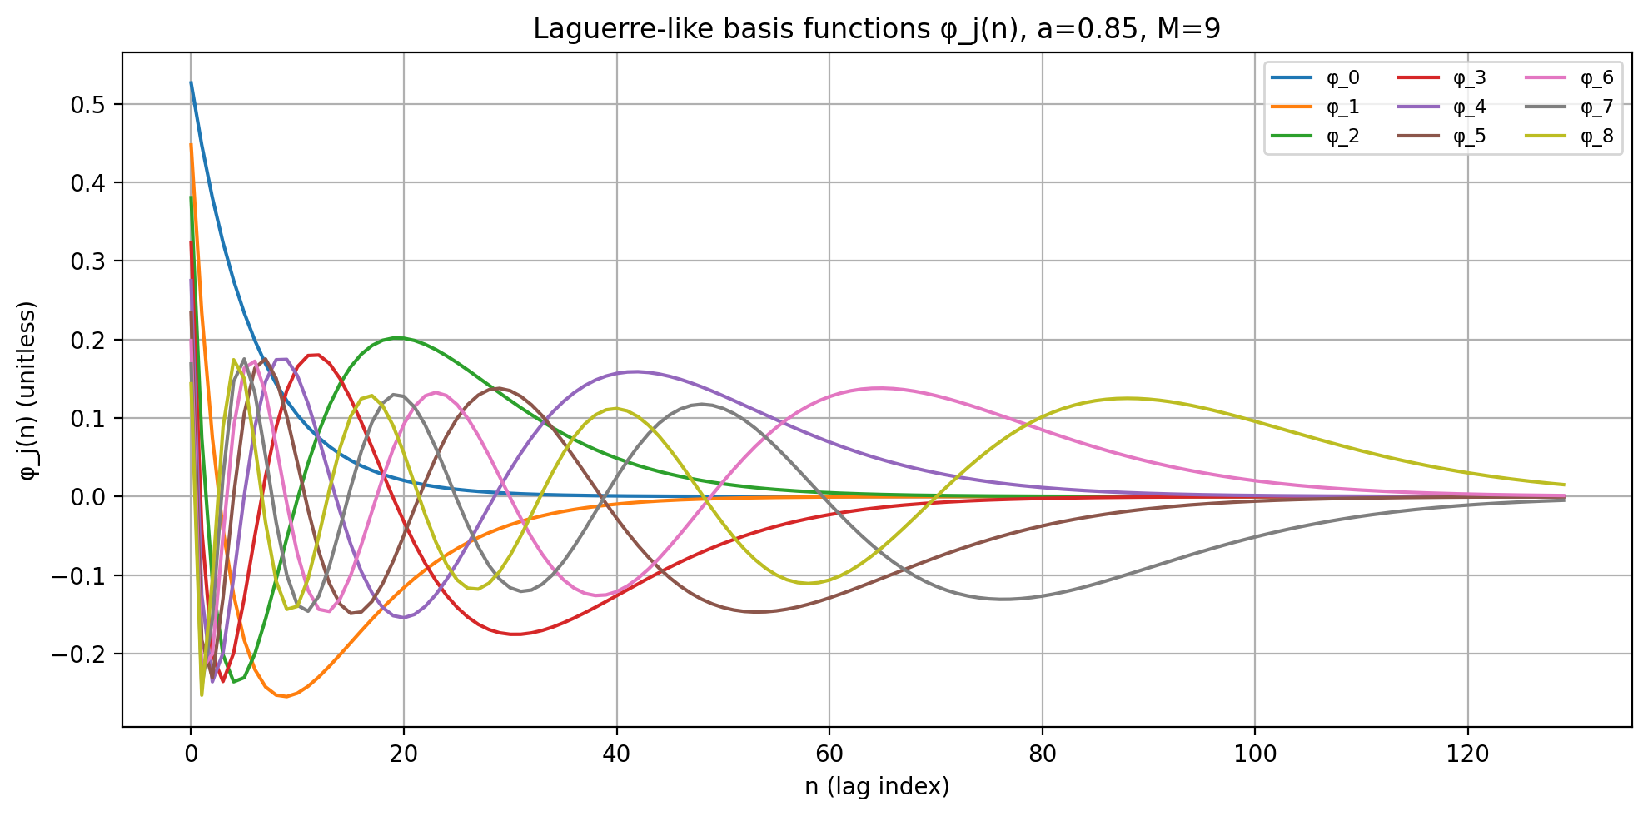
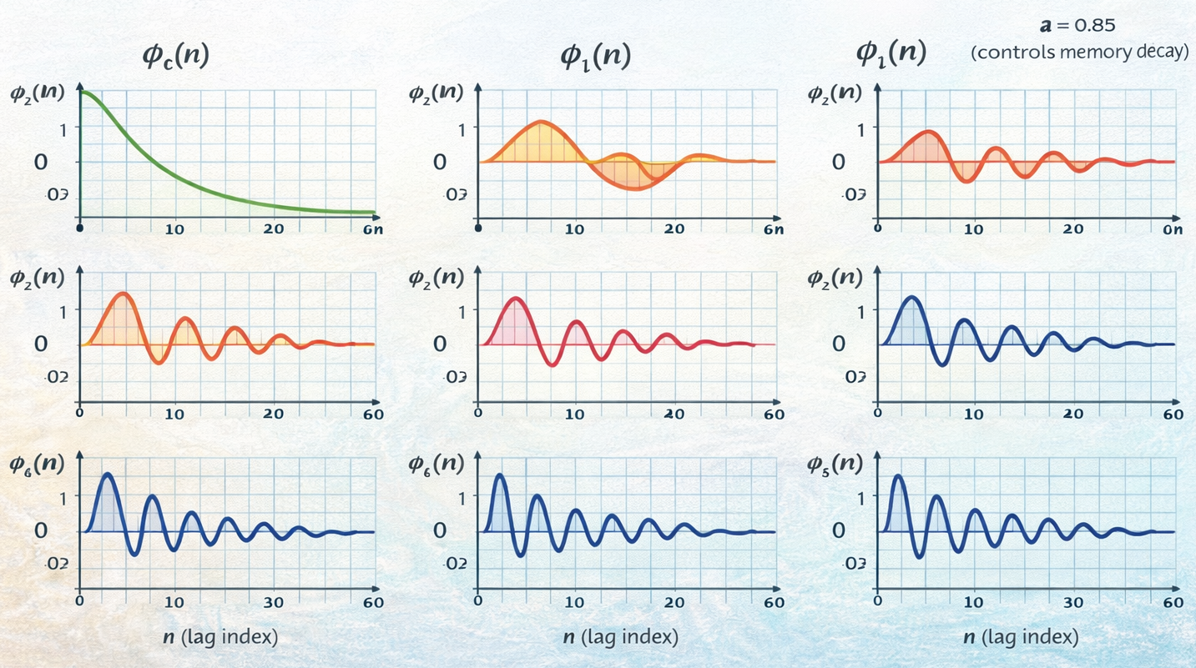
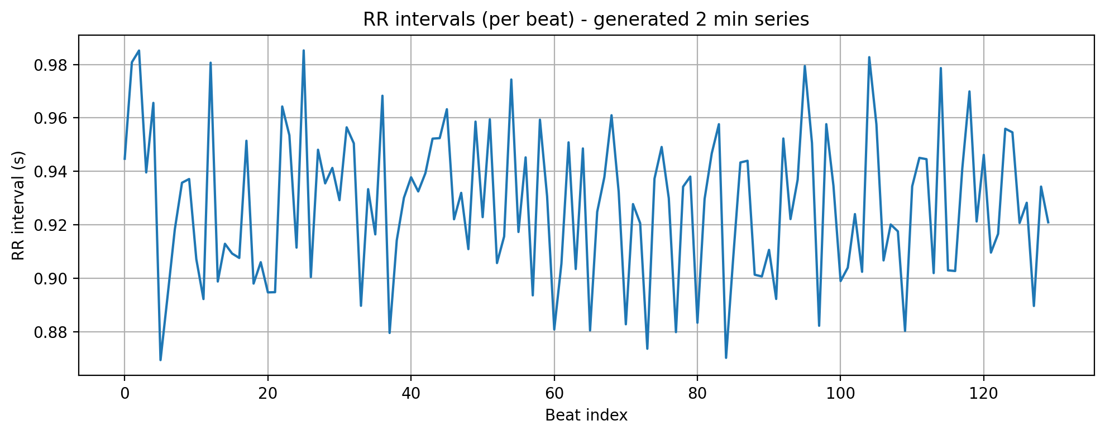
Laguerre Functions
Notes:
each Laguerre function corresponds to a family of frequencies weighted over time.
Low-order Laguerre → low-pass, tonic behavior
Very high order → increasingly oscillatory but still causal and decaying
Laguerre expansions encode temporal structure, not explicit frequency bins.
“How does the recent past over multiple time scales influence the present?”
a≈0: very short memory
$a≈1$: very long memory
memory length≈1/1-a
M=1: single low-pass memory
$M=3$: baseline + trend + curvature
$M=9$: multiple oscillatory memory channels (typical in autonomic modeling)
​

Slide 4
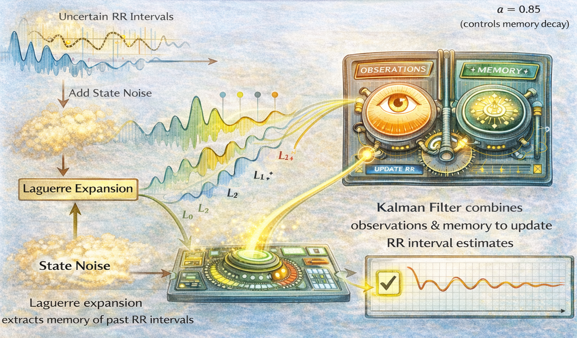
Notes:
Alpha parameter and M parameters

Slide 5
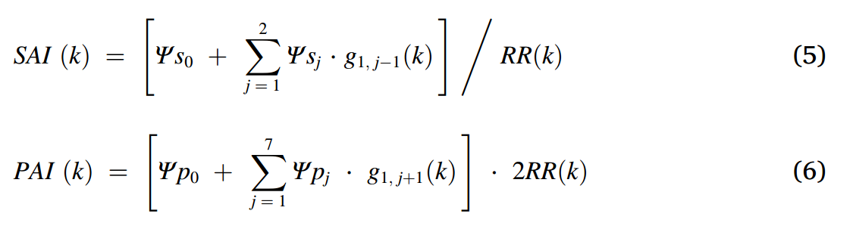
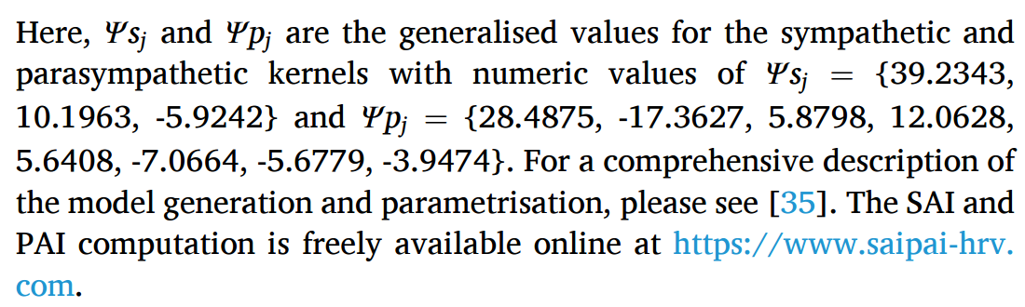
Notes:
Explain small and large RR intervals and the impact on Sai and PAI

Slide 6
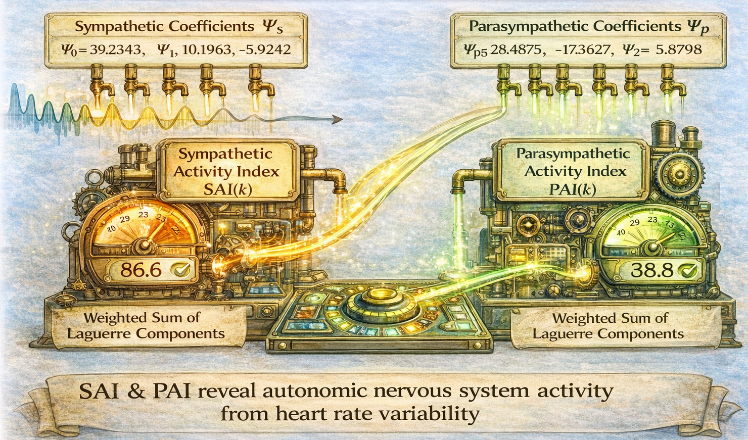

Slide 7
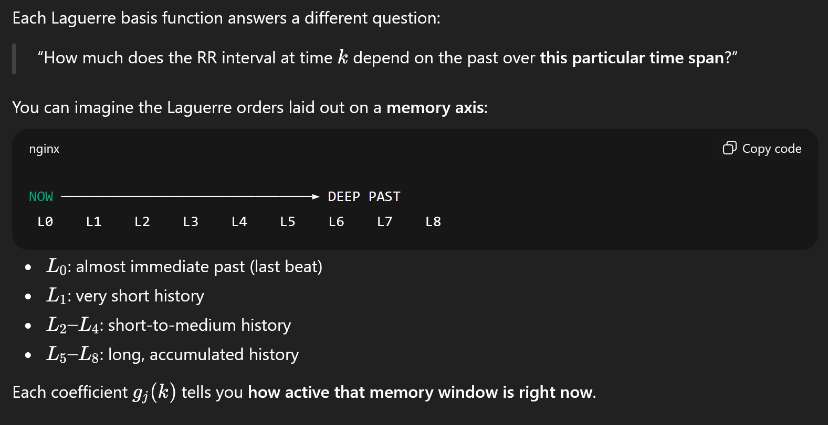

Slide 8
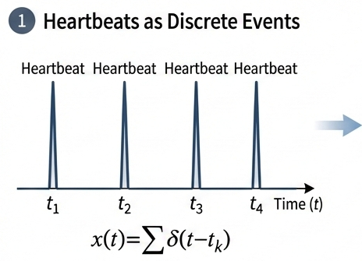
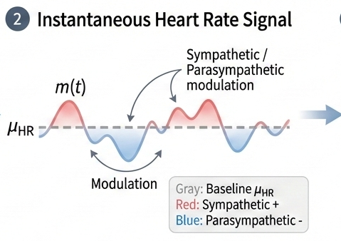
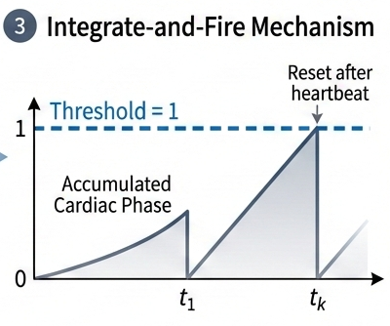
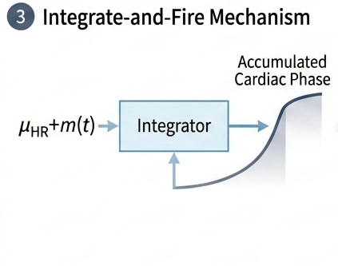
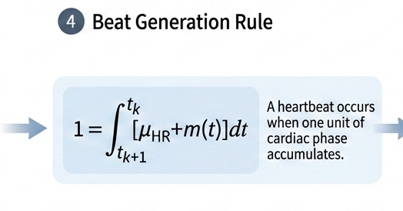
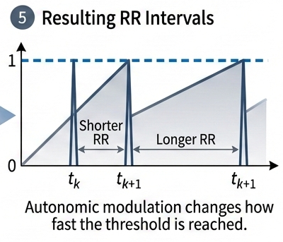
Standard IPFM Model

Slide 9
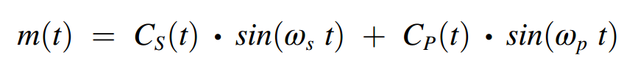
Standard IPFM Model
The standard IPFM model treats heartbeats as threshold crossings of a pacemaker whose speed is modulated by two fixed-frequency oscillators representing sympathetic and parasympathetic rhythms.
The strengths of these oscillators vary slowly over time and are estimated from the geometry of the Poincaré plot, anchoring the model firmly in the HRV spectral paradigm. It is physiologically interpretable but fundamentally frequency-based and limited under strong nonstationarity.

Slide 10
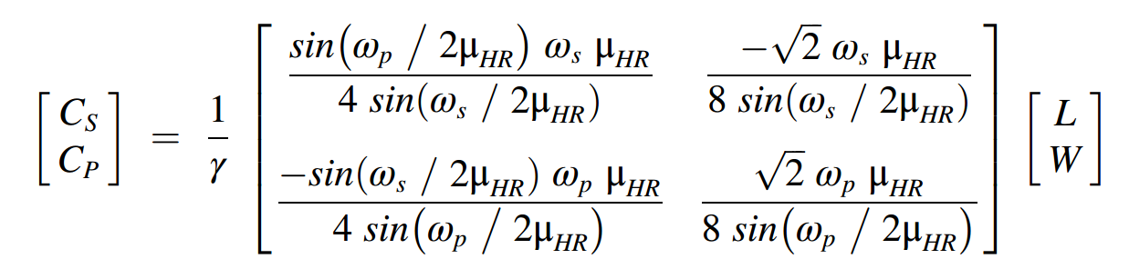
Standard IPFM Model
0.1 Hz – Baroreflex band
Unmixing of LF and HF oscillations
0.25 Hz – Respiratory band
Mixing of LF and HF oscillations

Slide 11
Standard IPFM Model
How do continuous sympathetic and parasympathetic modulations produce discrete RR intervals?
At the heart of the IPFM model is a leaky integrator - an internal variable that accumulates over time. When it reaches a threshold → a heartbeat occurs. Then it resets and starts again
The model assumes that autonomic control acts through a single modulation signal:m(t)
IPFM assumes that sympathetic and parasympathetic effects combine linearly at this stage
Each Poincaré-plot dimension is influenced by both sympathetic and parasympathetic oscillations, so every conversion term must account for both ωs​ and ωp​.

Slide 12
1. Start from physiology
Parasympathetic (vagal) control
Acts directly on the sinoatrial node
Neurotransmitter (acetylcholine) acts very fast
Effect appears within 1–2 beats
This is why vagal tone:
dominates beat-to-beat variability
produces sharp, high-frequency changes
strongly modulated by respiration, less smooth.
complex, time-varying patterns
Sympathetic control
Acts through slower biochemical pathways
Requires neurotransmitter diffusion and receptor activation
Effect builds over many seconds
captures tonic, slowly varying control
Laguerre order | Memory character
low (j) | immediate past
medium (j) | short-term trend
high (j) | long-term accumulation
SAI uses fewer but earlier Laguerre modes to track smooth sympathetic drift, while PAI uses more but later Laguerre modes to capture complex parasympathetic beat-to-beat modulation.

